Slide 1
Structural Patterns
Deal with objects delegating responsibilities to other objects. This results in a layered architecture of components with low degree of coupling.
Facilitate inter-object communication when one object is not accessible to the other by normal means or when an object is not usable because of its incompatible interface.
Provide ways to structure an aggregate object so that it is created in full and to reclaim system resources in a timely manner.

Slide 2
Structural class patterns use inheritance to combine the interfaces or implementations of multiple classes. Structural class patterns are relatively rare.
Structural object patterns use object composition to combine the implementations of multiple objects. They can combine the interfaces of all the composed objects into one unified interface or they can provide a completely new interface.

Slide 3
Adapter Pattern
The Adapter pattern is used so that two unrelated interfaces can work together. The joining between them is called an Adapter. This is something like we convert interface of one class into interface expected by the client. We do that using an Adapter.

Slide 4
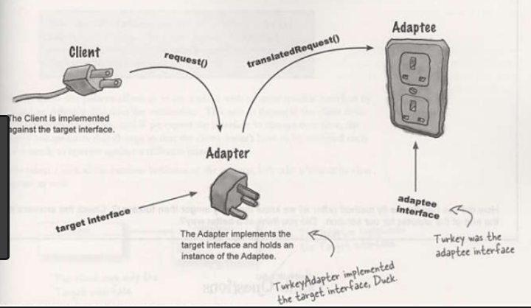
Example

Slide 5
Intent
Convert the interface of a class into another
interface, the clients expect. Adapter lets
classes work together that couldn't otherwise
because of incompatible interfaces.

Slide 6
Also Known As
Wrapper

Slide 7
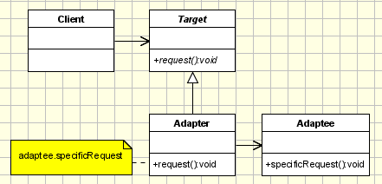
Class diagram
The classes/objects participating in adapter pattern:
Target - defines the domain-specific interface that Client uses.
Adapter - adapts the interface Adaptee to the Target interface.
Adaptee - defines an existing interface that needs adapting.
Client - collaborates with objects conforming to the Target interface.

Slide 8
Example
Real time example: The Adapter is something like this. It will be having the plug of suitable for 15 Amp and a socket suitable for a 5 Amp plug. So, that the 5 Amp plug which here is the client can fit in and also the server which here is the 15 Amp socket can give the output.
A real life example could be a case of card reader which acts as an adapter between memory card and a laptop. You plugins the memory card into card reader and card reader into the laptop so that memory card can be read via laptop.
Let us build an application to validate a given customer address. This application can be part of a larger customer data management application.
Let us define a Customer class

Slide 9
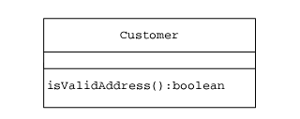
Example
Different client objects can create a Customer object and invoke the isValidAddress method to check the validity of the customer address. For the purpose of validating the address, the Customer class expects to make use of the AddressValidator interface

Slide 10
Example
Let us define one such validator USAddress to validate a given U.S. address.
The USAddress class is designed to implement the AddressValidator interface so that Customer objects can use USAddress instances as part of the customer address validation process without any problems.

Slide 11
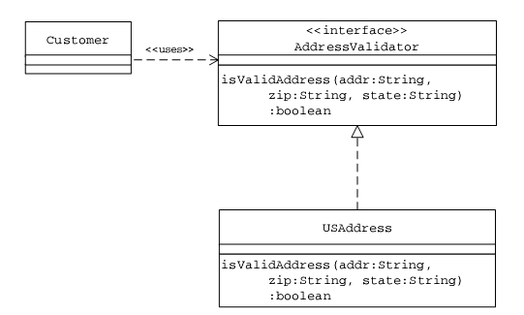
Customer/USAddress Validator: Class Association

Slide 12
Need for Adapter
Let us say that the application needs to be enhanced to deal with customers from Canada as well. This requires a validator for verifying the addresses of Canadian customers. Let us assume that a utility class CAAddress, with the required functionality to validate a given Canadian address, already exists.

Slide 13
CAAdress Class with Incompatible Interface
class CAAddress {
public boolean isValidCanadianAddr(String inp_address,
String inp_pcode, String inp_prvnc) {
if (inp_address.trim().length() < 15)
return false;
if (inp_pcode.trim().length() != 6)
return false;
if (inp_prvnc.trim().length() < 6)
return false;
return true;
}
}//end of class

Slide 14
Need for Adapter
The CAAddress class offers an isValidCanadianAddr method, but the Customer expects an isValidAddress method as declared in the AddressValidator interface.
This incompatibility in the interface makes it difficult for a Customer object to use the existing CAAddress class.
One of the options is to change the interface of the CAAddress class.

Slide 15
Need for Adapter
Applying the Adapter pattern, a class adapter CAAddressAdapter can be designed as a subclass of the CAAddress class implementing the AddressValidator interface.
When a client object invokes the isValidAddress method, on the adapter instance, the adapter internally translates it into a call to the inherited
isValidCanadianAddr method.

Slide 16
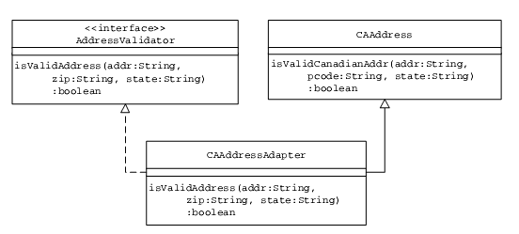
Class Adapter for the CAAddress Class

Slide 17
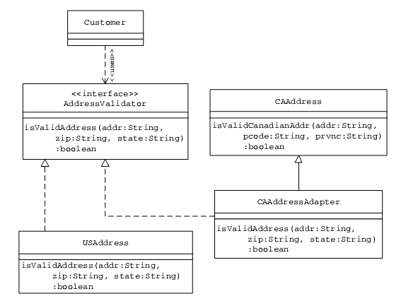
Address Validation Application: Using Class Adapter

Slide 18
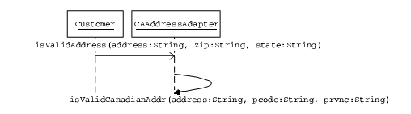
Address Validation Message Flow: Using Class Adapter

Slide 19
CLASS ADAPTERS VERSUS OBJECT ADAPTERS
Class Adapter
A class adapter is designed by subclassing the adaptee class. In addition, a class adapter implements the interface expected by the client object. When a client object invokes a class adapter method, the adapter internally calls an adaptee method that it inherited.
Object Adapter
An object adapter contains a reference to an adaptee object. Similar to a class adapter, an object adapter also implements the interface, which the client expects. When a client object calls an object adapter method, the object adapter invokes an appropriate method on the adaptee instance whose reference it contains.

Slide 20
Object Adapter
Let us assume that the client expects the AddressValidator interface to be available as an abstract class instead of a Java interface.
Because the adapter CAAdapter has to provide the interface declared by the AddressValidator abstract class, the adapter needs to be designed to subclass the AddressValidator abstract class and implement its abstract methods.

Slide 21
Object Adapter
Because multiple inheritance is not supported in Java, now the adapter CAAddressAdapter cannot subclass the existing CAAddress class as it has already used its only chance to subclass from another class.
Applying the object Adapter pattern, the CAAddressAdapter can be designed to contain an instance of the adaptee CAAddress.

Slide 22
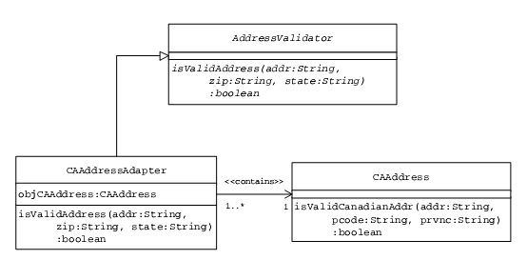
Object Adapter for the CAAddress Class

Slide 23
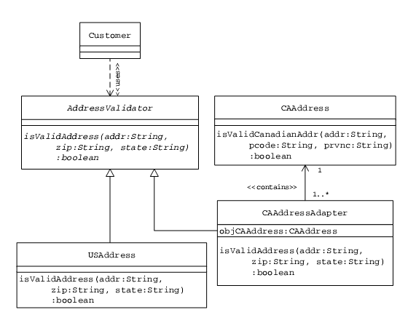
Address Validation Application: Using Object Adapter

